Slide 1
Let’s learn
Polygons

Slide 2

Let’s sketch or doodle something in our notebooks
Guess what?
You just created a CURVE !
Out of these,
first two are different
as they are closed curves.
and the third one is an open curve
POLYGON
Closed Curves
Of these closed curves,
first curve is made up of line segments
And this is what we call Polygon.
A simple closed curve made up of line segments is known as a POLYGON.
Not a Polygon
How about the second closed curve ?
Since this closed curve is not made up of line segments
it’s not a POLYGON
Open Curve
Let’s learn about POLYGONS in detail

Slide 3
A Polygon is a Simple Closed Curve made up of line segments
How many minimum line segments are needed to form a polygon?
1 Line Segment ?
2 Line Segments ?
3 Line Segments ?
It is not a Polygon
It is also not a Polygon
It is a simple closed curve and also made up of line segments
So, it is a Polygon
Therefore, minimum 3 line segments are needed to form a polygon.
3-sided polygon is known as a triangle,
also referred to as a 3-gon.
4-sided polygon is known as a quadrilateral
In general, an n-sided polygon is called n-gon.
5-sided polygon is known as a pentagon
6-sided polygon is known as a hexagon

Slide 4
Consider a Pentagon
Number of Sides:
3
5
4
Number of Vertices:
5
Recall:
5
2
Number of Diagonals:
5
A diagonal is a line segment that connects two non-adjacent vertices of the polygon.
1
Number of Angles:
5
No! There are 10
Let me tell you how
INTERIOR ANGLES
Angles formed inside the polygon
There are two types of Angles
EXTERIOR ANGLES
Angles formed outside the polygon by extending one of the sides
Now let’s look at Types of Polygons

Slide 5
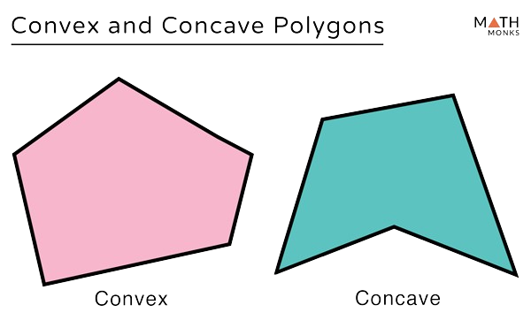
Polygons are categorised in two ways
Can you recall what do we call such polygons?
Our syllabus only has Convex Polygons
Based on their side length
Based on their interior angles
All sides and angles are equal
2. All sides and angles
are not equal
All angles are
less than 180º
2. At least one angle
is more than 180º
REGULAR POLYGONS
IRREGULAR POLYGONS
CONVEX POLYGON
CONCAVE POLYGON
Its all sides are equal
All interior angles are equal
All exterior angles are equal
Its all sides are not equal
All interior angles are not equal
All exterior angles are not equal

Slide 6

We have already learnt about Sides and Vertices of Polygons in earlier grades.
In this chapter ‘Polygons’
we need to learn 4 things to solve the problems
1. Diagonals of a Polygon
2. Interior angles of a Polygon
3. Exterior angles of a Polygon
4. Relationship between Interior and corresponding Exterior angle
This is one of the easier chapters of grade 8
If you’ll master these, all marks are yours
Let’s get started

Slide 7
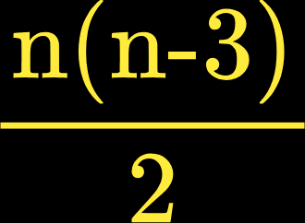
Diagonals
Let’s recall what a diagonal is.
Diagonal is a line segment joining non-adjacent (non neighbouring) vertices.
Let’s look at diagonals of some polygons
starting with the least sided polygon
Triangle
Quadrilateral
Pentagon
Hexagon
No. of Diagonals:
0
No. of Diagonals:
2
No. of Diagonals:
5
No. of Diagonals:
9
Can you find how many diagonals will be there in 15-sided polygon?
or 30-sided polygon?
or 99-sided polygon?
Tricky, right?
What if there was a formula?
For any n-sided polygon
, number of diagonals =

Slide 8
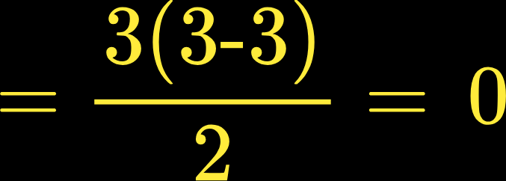
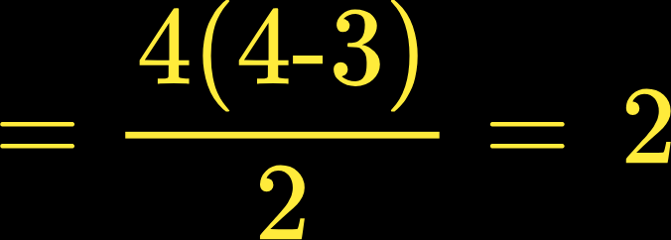
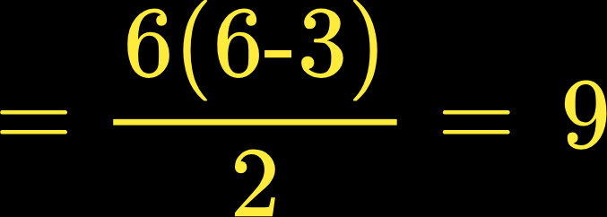
No. of diagonals =
Let’s verify this formula
Consider a few polygons whose diagonals we’ve found earlier
Number of vertices (n) =
3
Triangle
Number of diagonals =
Number of vertices (n) =
4
Quadrilateral
Number of diagonals =
Number of vertices (n) =
6
Hexagon
Number of diagonals =

Slide 9

Q:
Find out the number of diagonals
for a 30-sided polygon.
Solution:
n = 30
For a 30-sided polygon,
No. of diagonals =
=
=
= 405

Slide 10
bddc4e6c-540b-48e1-a11a-373189b9bff6

Slide 11
Let’s look at Interior Angles of a Polygon

Slide 12
Angles
Let's begin with Interior angles now
Consider a triangle
A triangle has 3 interior angles.
Can you recall the sum of its 3 interior angles?
Yes! Its 180°
3
That is,
the sum of interior angles of a triangle = ∠1 + ∠2 + ∠3 = 180⁰
This is ANGLE SUM PROPERTY of the triangle
1
2
Now consider a Quadrilateral
A quadrilateral can be divided into two triangles
using a diagonal
2
3
∠1 + ∠2 + ∠3 = 180⁰
6
∠4 + ∠5 + ∠6 = 180⁰
1
5
4
∠1 + ∠2 + ∠3 + ∠4 + ∠5 + ∠6 = 180⁰ + 180⁰
= 360⁰
Therefore,
to find Sum of Interior Angles of a Polygon
just see how many triangles the polygon can be divided into.

Slide 13
Polygon | No. of sides (n) | No. of triangles the polygon can be divided | Sum of Interior Angles
Can you find the relationship between
the number of sides and number of triangles?
3
1
1 x 180⁰ = 180⁰
No. of triangles in a polygon are 2 less than number of sides
2
4
2
2 x 180⁰ =
360⁰
To find sum of interior angles,
1
we have to multiply number of triangles by 180⁰
1
3
Therefore,
2
5
3
3 x 180⁰ =
540⁰
Sum of interior angles of a polygon =
4
1
2
3
6
4
4 x 180⁰ =
720⁰
(n-2)
x 180⁰
5
4
7
This is the
Angle Sum Property
Polygons
1
5
5 x 180⁰ =
900⁰
2
3

Slide 14
For any n-sided polygon,
sum of interior angles can be determined by
finding out the number of triangles the polygon can be divided into
For each triangle,
The Sum of Interior Angles is 180⁰
Into how many triangles, a 30 sided polygon can be divided?
28 triangles
28 x 180⁰
Into how many triangles, a 15 sided polygon can be divided?
13 triangles
13 x 180⁰
Into how many triangles, a 27 sided polygon can be divided?
25 triangles
25 x 180⁰
Therefore, The Sum of Interior Angles =
(n-2) x 180⁰
In your book,
you might see the formula as
Sum of Interior Angles =
(2n - 4) x 90⁰
But it’s nothing different!
If you take 2 common,
(n - 2)
x 90⁰
2
and multiply that by 90⁰
(n - 2)
x 180⁰
We get back the same formula

Slide 15
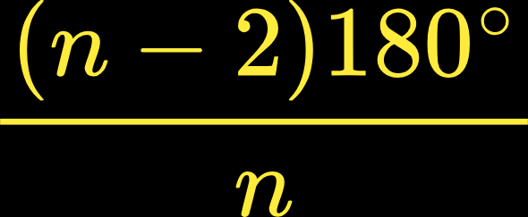
For any type of polygon
Regular or Irregular Polygon
, Sum of interior angles is always equal to
(n-2) x 180⁰
REGULAR POLYGONS
IRREGULAR POLYGONS
Since all angles of a Regular Polygon are equal
But all angles of an Irregular Polygon are not equal
That means,
we can find Each Interior Angle of a Regular polygon
So there’s no formula for this
Generally, in questions related to Irregular polygons, you will be asked to find the missing angle!
Each Interior Angle of n-sided polygon =
Let’s see how !

Slide 16



Regular Polygon
Q: Find the measure of each of the interior angle of a regular polygon having 10 Sides
Solution:
Step 1: Find the Sum of interior angles of the given Polygon
We know that, Sum of Interior angles = (n-2) x 180⁰
No. of sides = n =10
= (10 -2) x 180⁰
= 8 x 180⁰
= 1440⁰
Step 2: Find the measure of each interior angle of a Regular Polygon
We know that, Measure of each interior angle =
∴ Measure of each interior angle = 144⁰

Slide 17
Irregular Polygon
Find the measure of x in the given figure
60^{O}
Solution:
x ^{O}
Step 1: Find the Sum of interior angles of the given Polygon
110^{O}
120^{O}
We know that, Sum of Interior angles = (n-2) x 180⁰
No. of sides = n =4
= (4 -2) x 180⁰
= 2 x 180⁰
= 360⁰
Step 2: Find the missing angle
120⁰ + 110⁰ + 60⁰ + x = 360⁰
290⁰
+ x = 360⁰
x = 360⁰ - 290⁰
x = 70⁰
∴ The value of x = 70⁰

Slide 18
Let’s look at Exterior Angles of a Polygon

Slide 19
Consider a Pentagon.
6
What is the Sum of its Interior Angles?
Use: Sum of interior angles = (n-2) x 180⁰
180^{O}
1
So, Sum of its all 5 interior angles is 540º
10
Now, extend the side and create its 5 exterior angles
180^{O}
5
2
180^{O}
7
Observe the relationship between interior and corresponding exterior angle?
At each vertex,
the exterior angle and interior angle form a linear pair.
ㄥ5 + ㄥ10 = 180º
9
4
3
That is, at each vertex,
180^{O}
180^{O}
Interior angle + Exterior angle = 180º
8
Therefore, at all 5 vertices
Sum of all 5 Interior angle + Sum of all 5 Exterior angle
= 180⁰ + 180⁰ + 180⁰ + 180⁰ + 180⁰
= 5 x 180⁰
ㄥ1 + ㄥ2 + ㄥ3 + ㄥ4 + ㄥ5
= 900º
540º
+ Sum of all 5 Exterior angle
= 900º
Sum of all 5 Exterior angle
= 900º - 540º
Sum of all 5 Exterior angle
= 360º

Slide 20
Let’s take one more example: HEXAGON
7
180^{O}
180^{O}
What is the Sum of its Interior Angles?
Use: Sum of interior angles = (n-2) x 180⁰
1
2
8
So, Sum of its all 6 interior angles is 720º
12
Now, look at its 6 exterior angles
180^{O}
3
6
180^{O}
9
Again,
at each vertex,
Interior angle + Exterior angle = 180º
11
5
4
180^{O}
180^{O}
Therefore, at all 6 vertices:
10
Sum of all 6 Interior angle + Sum of all 6 Exterior angle
= 6 x 180⁰
= 1080º
ㄥ1 + ㄥ2 + ㄥ3 + ㄥ4 + ㄥ5 + ㄥ6
720º
+ Sum of all 6 Exterior angle
= 1080º
Sum of all 6 Exterior angle
= 1080º - 720º
Sum of all 6 Exterior angle
= 360º

Slide 21
If you do the same activity for 3-sided polygon,
or 4-sided polygon,
or even 99-sided polygon,
you’ll observe that
Sum of all 3 exterior angles = 360º
Sum of all 4 exterior angles = 360º
Sum of all 99 exterior angles = 360º
∴ For any n-sided polygon,
Sum of all Exterior Angles = 360º
Geometry is mostly about angles!
So master this key property now.
It will help you shine in your future studies

Slide 22
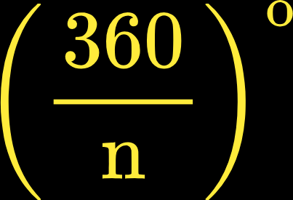
For any type of polygon
Regular or Irregular Polygon
, Sum of Exterior angles is always equal to
360⁰
REGULAR POLYGONS
IRREGULAR POLYGONS
Since all angles of a Regular Polygon are equal
But all angles of an Irregular Polygon are not equal
That means,
we can find Each Exterior Angle of a Regular polygon
So there’s no formula for this
Each Exterior Angle of n-sided polygon =
Let’s see how !

Slide 23
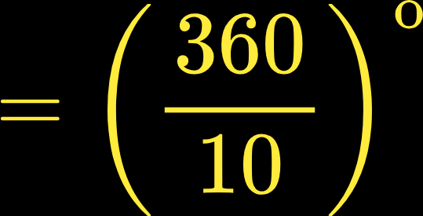

Regular Polygon
Q: Find the measure of each of the exterior angle of a regular polygon having 10 Sides
Solution:
Step 1: Find the Sum of exterior angles of the given Polygon
We know that, Sum of exterior angles = 360⁰
Step 2: Find the measure of each exterior angle of a Regular Polygon
We know that, Measure of each exterior angle =
No. of sides = n =10
∴ Measure of each exterior angle = 36⁰

Slide 24
Irregular Polygon
G
Q: Find the measure of x in the given figure
90^{O}
Solution:
D
C
H
50^{O}
Step 1: Find the Sum of exterior angles of the given Polygon
xº
A
We know that, Sum of exterior angles = 360⁰
115^{O}
B
F
E
Step 2: Find the missing angle
115⁰ + 50⁰ + 90⁰ + x = 360⁰
255⁰
+ x = 360⁰
x = 360⁰ - 255⁰
x = 105⁰
∴ The value of x = 105⁰

Slide 25
Do you Remember?
There’s a relationship between
each interior
and corresponding exterior angle.
Let’s recall once again.

Slide 26



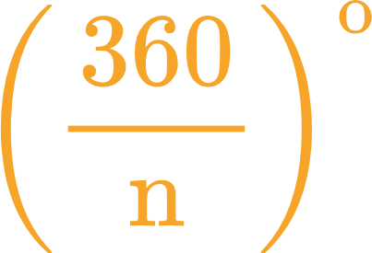




Consider an Equilateral Triangle
120°
Each Interior angle =
60°
Each exterior angle =
60°
60°
120°
180^{O}
Therefore, at each vertex,
Interior angle + Exterior angle = 180º
120°
90°
Consider a Square now
90°
90°
90°
Each Interior angle =
90°
90°
90°
Each exterior angle =
180^{O}
90°
Therefore, at each vertex,
Interior angle + Exterior angle = 180º
Interior angle and its corresponding Exterior angle forms a Linear Pair i.e. Sum = 180°

Slide 27
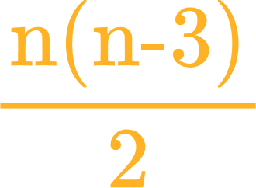
Summary
Let’s summarize super important formula for your exams,
so let's stay sharp and focused!
For any n-sided polygon
, number of diagonals =
For any n-sided polygon
, sum of n interior angles =
(n-2) x 180⁰
For any n-sided Regular Polygon,
each interior angle =
For any n-sided polygon
, sum of n exterior angles =
360º
For any n-sided Regular Polygon,
each exterior angle =
Interior angle and its corresponding Exterior angle forms a Linear Pair i.e. sum = 180°

Slide 28
Now let’s understand the Types of Questions
in POLYGONS!

Slide 29
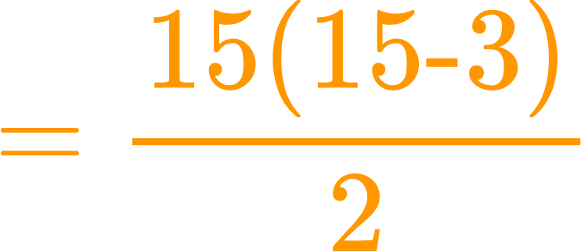
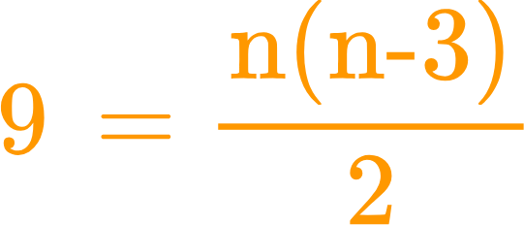
Question Category 1
Direct Application of the No. of Diagonals formula
Q: Find the no. of diagonals for 15 sided polygon
Given:
To find:
No. of diagonals
n
Given:
n = 15
Substitute this value of n in the formula
To find:
No. of diagonals
=
No. of diagonals =
Q: Which polygon has 9 diagonals?
Given:
No. of diagonals
To find:
n
Given:
No. of diagonals
= 9
Substitute this value in the formula
To find:
n
:
Let’s see how to solve such questions

Slide 30

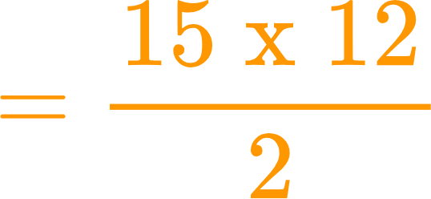
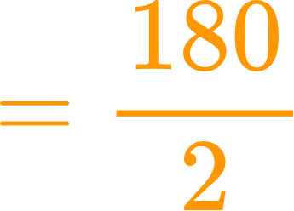

Q: Find the no. of diagonals for 15 sided polygon
Step 1 : Identify the value of n
n ->
Number of sides
Here,
the value of n =
15
Step 2: Substitute the value of n in the formula
Number of diagonals in a polygon =
∴
Number of diagonals of a 15 sided polygon =
90

Slide 31


Question Category 2
Direct Application of the Sum of Interior Angle formula
Q: Find the sum of interior angles of 15 sided polygon
Given:
To find:
Sum of Interior Angles
n
Given:
n = 15
Substitute this value of n in the formula
To find:
Sum of Interior Angles
=
Sum of Interior Angles = (n-2) x 180⁰
Q: Sum of interior angles of a polygon is 1080⁰.
Find the polygon
Given:
Sum of Interior Angles
To find:
n
Given:
Sum of Interior Angles
= 1080⁰
Substitute this value in the formula
To find:
n
:
1080⁰ =
Let’s see how to solve such questions

Slide 32


Q: Find the sum of interior angles of 15 sided polygon
Step 1 : Identify the value of n
n ->
Number of sides
Here,
the value of n =
15
Step 2: Substitute the value of n in the formula
Sum of interior angles =
∴
Sum of interior angles of a 15 sided polygon =
2340º

Slide 33


Q: If the sum of all interior angles of a polygon is 1080º, which polygon is it ?
Step 1: Substitute the value in the formula
We know that,
Sum of interior angles =
given
1080⁰ =
Step 2 : Identify the value of n
1080⁰ =
6 =
∴ n = 8
6 + 2 = n
An 8-sided polygon is Octagon

Slide 34
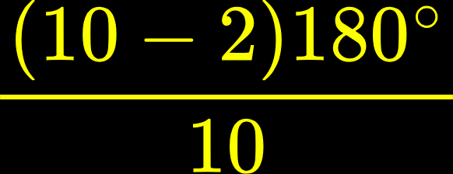
Question Category 3
Direct Application of Each Interior Angle of Regular Polygon formula
Q: Find the measure of each interior angle of 10-sided polygon
Given:
To find:
Each Interior Angle
n
Given:
n = 10
Substitute this value of n in the formula
To find:
Each Interior Angle
=
Each Interior Angle of =
Regular Polygon
Q: For which regular polygon, each interior angle is of 108⁰
Given:
Each Interior Angle
= 108⁰
Given:
Each Interior Angle
To find:
n
Substitute this value in the formula
To find:
n
:
108⁰ =
Let’s see how to solve such questions

Slide 35
Q: Find the measure of each of the interior angle of a regular polygon having 10 Sides
Solution:
Step 1: Find the Sum of interior angles of the given Polygon
We know that, Sum of Interior angles = (n-2) x 180⁰
No. of sides = n =10
= (10 -2) x 180⁰
= 8 x 180⁰
= 1440⁰
Step 2: Find the measure of each interior angle of a Regular Polygon
We know that, Measure of each interior angle =
∴ Measure of each interior angle = 144⁰

Slide 36
Q :
For which regular polygon, each interior angle is of 108⁰
Solution:
Step 1: Find the measure of each interior angle of a Regular Polygon
We know that, Measure of each interior angle =
108⁰
=
Cross multiply
Step 2: Find the value of n by solving the equation
108 n
= (n-2) 180
n
= 360
72
108 n
= 180 n
– 360
180 n – 108 n
= 360
n = 5
72 n
= 360
Therefore, its a 5-sided regular polygon
Called Regular Pentagon

Slide 37
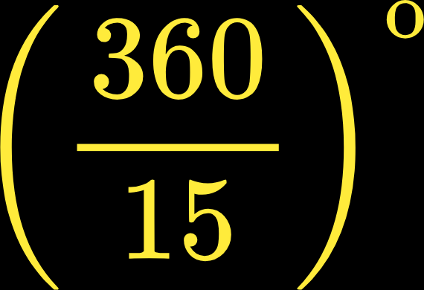
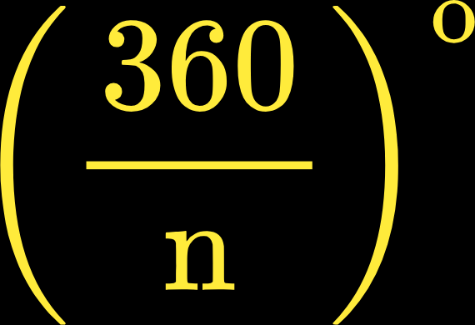
Question Category 4
Direct Application of Each Exterior Angle of Regular Polygon formula
Q: Find the measure of each exterior angle of 15-sided polygon
Given:
To find:
Each Exterior Angle
n
Given:
n = 15
Substitute this value of n in the formula
Each Exterior Angle of =
Regular Polygon
To find:
Each Interior Angle
=
Q: For which regular polygon, each Exterior angle is of 60⁰
Given:
Each Interior Angle
= 60⁰
Given:
Each Exterior Angle
To find:
n
Substitute this value in the formula
To find:
n
:
60⁰ =
Let’s see how to solve such questions

Slide 38
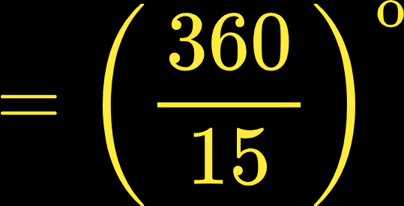

Q: Find the measure of each of the exterior angle of a regular polygon having 15 Sides
Solution:
Step 1: Find the Sum of exterior angles of the given Polygon
We know that, Sum of exterior angles = 360⁰
Step 2: Find the measure of each exterior angle of a Regular Polygon
We know that, Measure of each exterior angle =
No. of sides = n =15
∴ Measure of each exterior angle = 24⁰

Slide 39

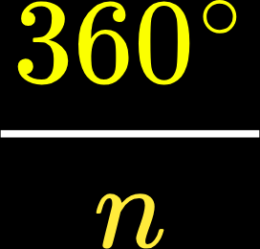
Q:
For which regular polygon, each Exterior angle is of 30⁰
Solution:
Step 1: Find the measure of each Exterior angle of a Regular Polygon
We know that, Measure of each Exterior angle =
30⁰
=
Cross multiply
Step 2: Find the value of n by solving the equation
30 n
= 360
n
= 360
30
n = 12
Therefore, its a 12-sided regular polygon
Called Regular Dodecagon

Slide 40
Question Category 5
Possibility of a Regular Polygon to exist with given angle
Each interior angles of a regular polygon is given.
Each exterior angles of a regular polygon is given.
In both the cases,
We have to find if the polygon exists or not
By finding the number of sides (n) using angle sum property
If the value of n is a whole number
which is greater than or equal to 3
only then the polygon would exist.

Slide 41

Q: Is it possible to have a polygon whose each Interior Angle is 45º
Step 1: Apply the formula to find Each Interior Angle of a Regular polygon
We know that, Measure of each interior angle =
Given: Each Interior angle =
45º
45⁰ =
Cross multiply
Step 2: Simplify to find n
45⁰ n =
(n - 2)180º
135⁰ n
= 360⁰
45⁰ n =
180⁰n
- 360⁰
n =
Since n is not the whole number
So, No!
Such a polygon does not exist
n =
2.67

Slide 42
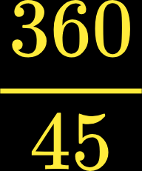
Q: Is it possible to have a polygon whose each exterior Angle is 45º
Step 1: Apply the formula to find Each Exterior Angle of a Regular polygon
We know that, Measure of each Exterior angle =
Given: Each Exterior angle =
45º
45⁰ =
Cross multiply
Step 2: Simplify to find n
∴ n =
n
= 8
Since n a whole number greater than 3
So, Yes!
Such a polygon exists

Slide 43
Question Category 6
Figure based Questions on Missing Angles
These are always figure based questions.
In these types of questions
we are given some angles
and we are asked to find an angle or few angles
Unknown angles in the figure but not asked
Given angles
Angles asked to find
To solve such questions,
First, we need to find the unknown angles which are not even asked but can be found directly (and easily) using Linear Pair or Angle Sum Property
2. Generally these Unknown angles once found can then help us in calculating the Angles
asked to find by once again using Linear Pair or Angle Sum Property
Let’s see how to solve such type of questions

Slide 44
Q Find the measure of x in the given figure
E
50^{O}
Step 1: Identify angles given and angles to find
ABCDE is an Irregular Pentagon
A
x ^{O}
x ^{O}
Given Angles:
D
Interior angle:
∠ AED = 50⁰
60^{O}
50^{O}
Exterior angles:
∠ ABX = 60⁰
and
∠ DCY = 50⁰
X
B
C
Y
Angles to find:
∠ EDC = x⁰
∠ EAD = x⁰
Step 3: Apply the Angle Sum Property
Sometimes, we need to find the angles which are not even asked to find
Sum of Interior angles of a Pentagon = 540⁰
Step 2: Find the unknown angles which can directly be found
∠AED + ∠ EAD + ∠EDC + ∠ ABC + ∠ DCB = 540⁰
Unknown Angles:
∠ ABC = ?
and
∠ DCB = ?
50⁰ + x⁰ + x⁰ + 120⁰ + 130⁰ = 540⁰
2x⁰ + 300⁰ = 540⁰
These angles can be easily found by applying:
Linear Pair property
∠ ABC + ∠ABX = 180⁰ ( Linear Pair)
∠ABC + 60⁰ = 180⁰
∠ABC = 120⁰
x⁰ = 120⁰
∠ DCB + ∠DCY = 180⁰ ( Linear Pair)
∠DCB + 50⁰ = 180⁰
∠ABC = 130⁰
∴ The value of x = 120

Slide 45


As mentioned before,
there are four types of problems in the book,
that we have just learnt about.
No. of Diagonals
Question Category 1
No. of diagonals for n sided polygon =
Sum of interior angles
Question Category 2
Question Category 3
Sum of n interior angles =
Each Interior angle =
Question Category 5
Finding possibility to get a polygon with given angle
Sum of exterior angles
Question Category 4
Sum of n exterior angles =
360º
Each Exterior angle =
Figure based Questions on Missing Angles
Question Category 6
Figure based Questions on Missing Angles

